Slide 1
Lending Loan Case Study
Atharv Ganla
Nikhil Mothkuri

Slide 2

Agenda
Data Analysis
Data Cleansing
Univariate and Segmented Univariate analysis
Bivariate and multi variate analysis
Conclusion

Slide 3
Introduction
The loan dataset is provided for past and existing customers. As Learners we have to understand and analyse the data to provide substantial evidence on the factors which can play a major role in delinquency of loans and those loans which are most likely not be paid fully.

Slide 4
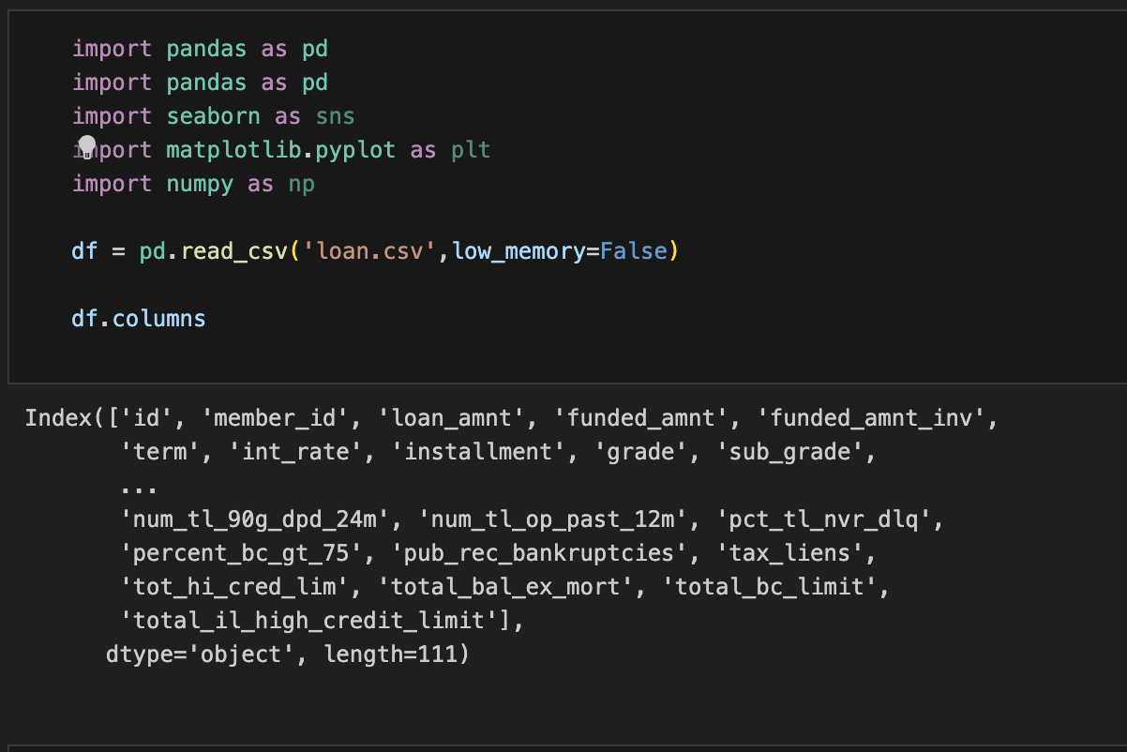
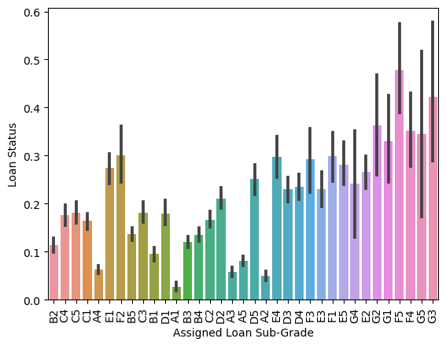
Data Analysis
Data Identification and Cleansing

Slide 5
Data Identification and Cleansing
1. A total of 39717 rows and 111 columns are present in the dataframe.
2. There are 54 columns with all the rows having null values.
3. There are 9 columns with only one single value in it.
4. There are columns with a lot of null values and only with few distinct values.
5. A total of 47 columns have been renamed.
6. 7 columns have been cleansed from objects to strings and int/float.

Slide 6
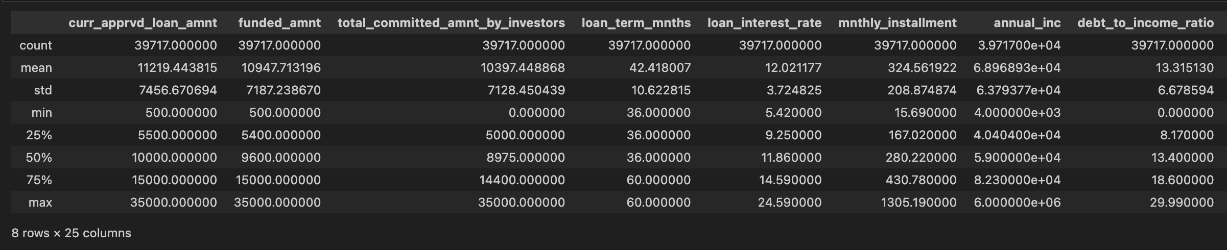
Univariate analysis
The univariate analysis revealed interesting insights between the following columns.
Interest rate ( min – 5.42, max – 24.59, heavier above mean )
Grade ( A to G )
sub grade ( Again subgrade by numbers )
income source verification status ( Not verified, verified, Source Verified )
Loan purpose ( debt –consolidation – higher, credit card and other – medium, renewable –lower )
Loan status ( Fully Paid, Current and Charged Off – needed for segmented and bivariate )
Employment length in years ( Values between 0 to 10+ years, most loans given at 4 years )
Home ownership ( Most values for Rent, Mortgage driving the ownership )
Debt to Income Ratio ( Most of the values above the mean value )
2. These are some of the values among other values that we did analysis on using
DataFrame.describe() which can found in the jupyter notebook

Slide 7
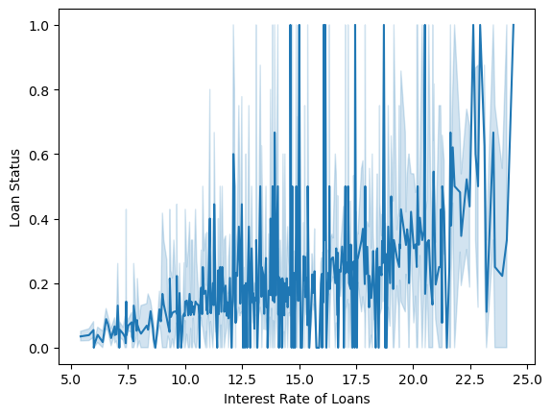
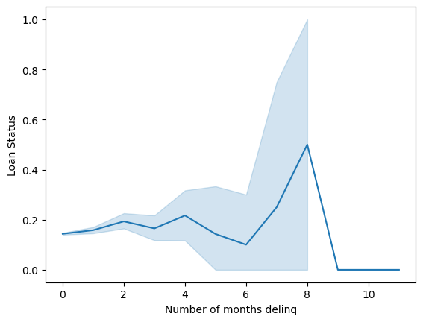
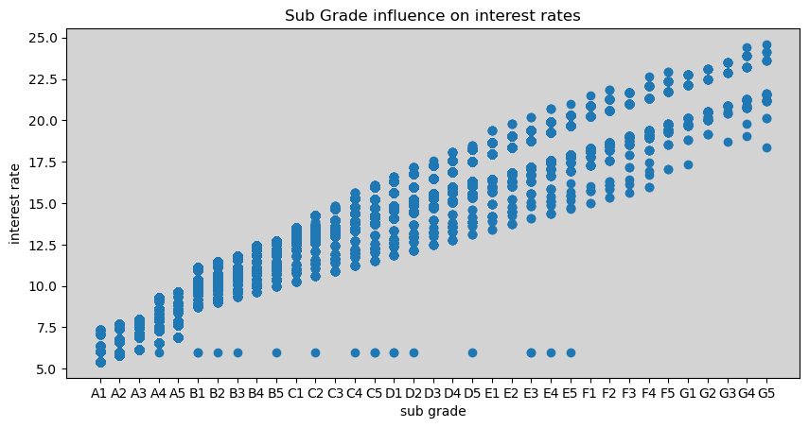
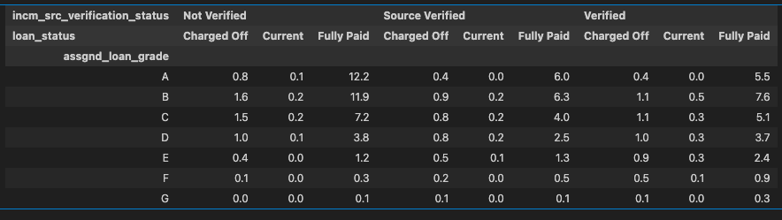
Univariate segmented analysis
Segmented univariate analysis is trying to establish a relationship between a single column and another column while segmenting it.
We have given some relationships that are established between columns

Slide 8
Univariate segmented analysis
The interest rate seems to be higher for the loans when we move from current loans to charged off loans
The number of 30+ months delinq in the last 2 years have between 8 and 10 as we move towards Charged Off loans

Slide 9
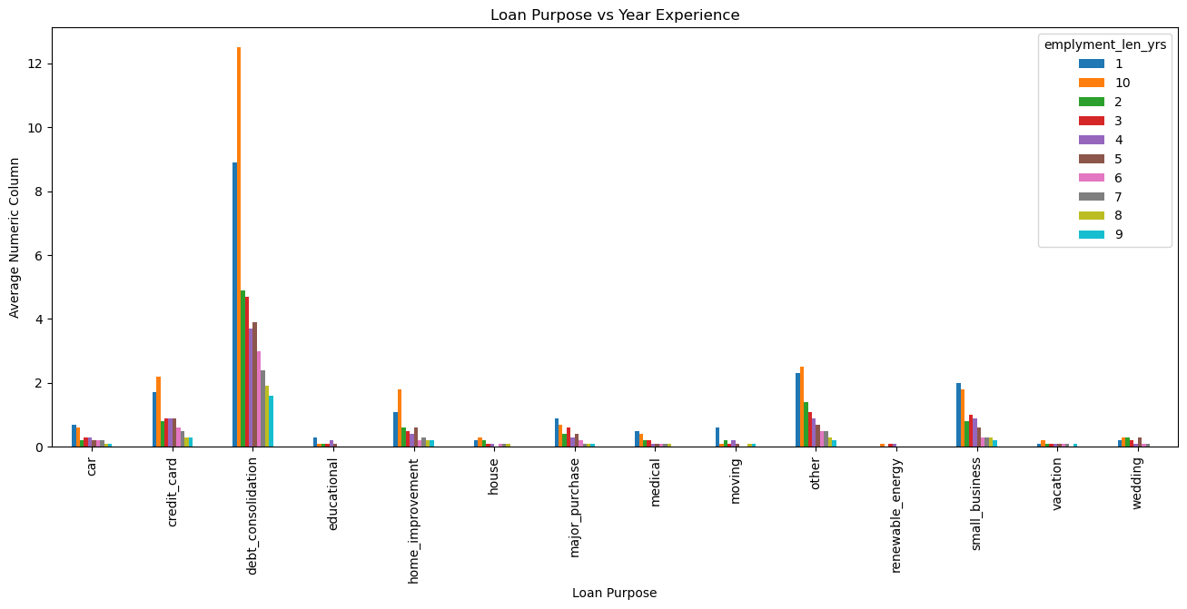
Univariate segmented analysis
The interest rates which have higher rate of interest tend to have more Charged Off loans.
The loan purpose and number of years of experience has a definite relationship. Debt consolidation tops the list with credit card and other come next but with lesser significance

Slide 10
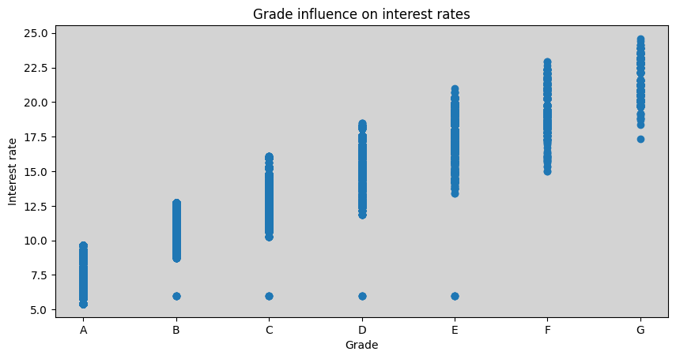
Univariate segmented analysis
The loan interest rate is inversely proportional to the assigned loan grade and hence, also the sub-grade.
Interest Rates increase as the loan grades decrease.
Looking at the sub-grade divisions, there is not much increment in the interest rate values when compared to the increment between grades.
This graph shows the almost straight line pattern of increment in the interest rates against the assigned loan sub-grades.

Slide 11
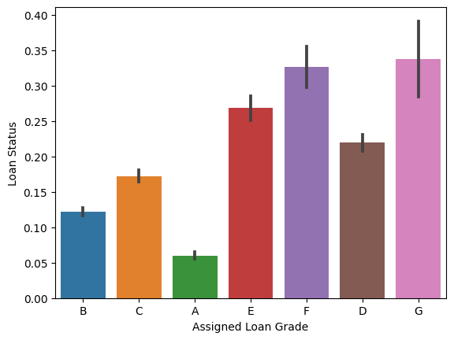
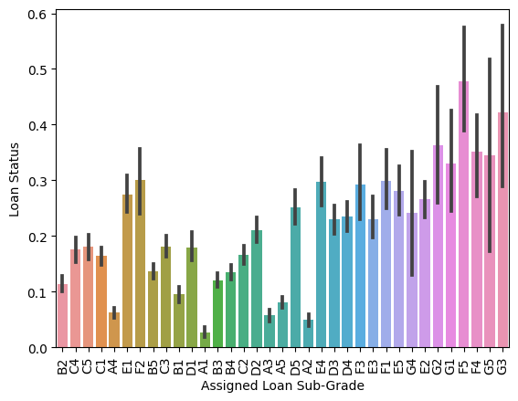
Univariate Segmented Analysis
Lower the assigned grade, higher the tendency of the account defaulting and getting charged-off.
Both the graphs depict the relation between the assigned grades and the tendency of the borrower of defaulting.
Lower the assigned sub-grade, higher the tendency of the account defaulting and getting charged-off.

Slide 12
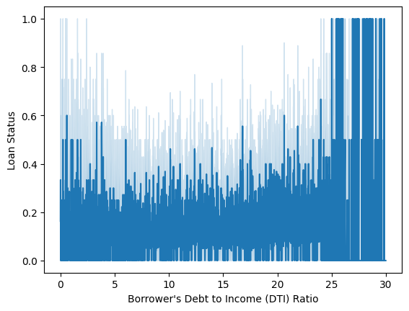
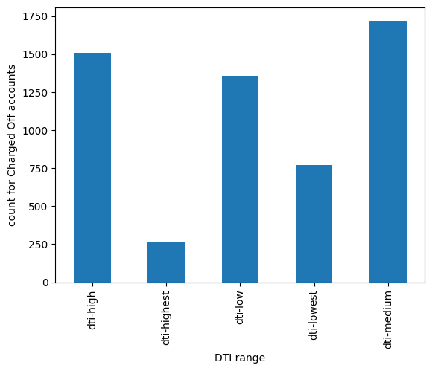
Univariate Segmented Analysis
This lineplot shows that greater the debt-to-income ratio, greater the tendency of the account defaulting and being marked as charged-off.
The spike in number of accounts getting charged-off can be see for the debt-to-income ratio values > 25.
The graph beside shows the count of Charged-off accounts and the range of debt-to-income ratio they fall under.
High and Medium DTI marks the majority of the charged-off accounts.

Slide 13
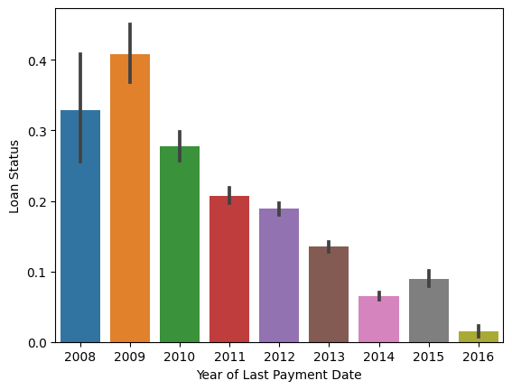
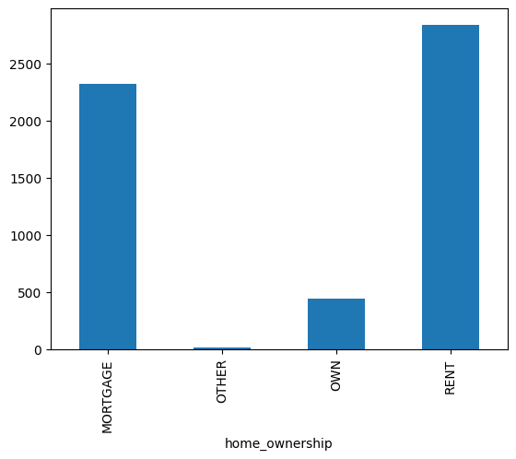
Univariate Segmented Analysis
As you can see in the year-wise graph, there is a steady decrease in accounts being marked as charged-off.
This goes to say that over the years, there is a decreasing in borrowers going delinquent
This graph shows the home ownership segments with the count of accounts that are marked as charged-off
Majority charged-off accounts belong to borrowers who have mortgaged their houses or are living in rented spaces.
This goes to show that Home Ownership is a factor that defines charged-off accounts.

Slide 14
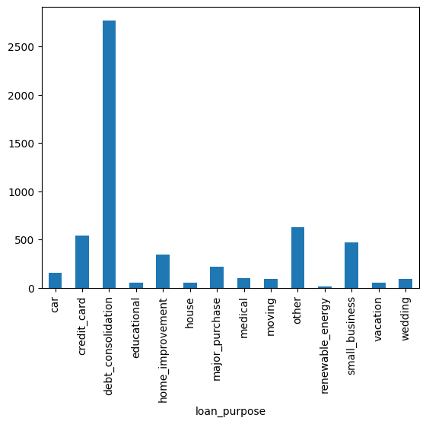
Univariate Segmented Analysis
This graph shows the varied purposes for taking loans, and the count of charged-off accounts for each of the purposes.
By looking at the graph, you can see that debt consolidation is a major contributor to the number of charged-off accounts.
This shows that borrowers have existing debts and are now borrowing from the Lending Club to pay off the previous debts.
In doing so, they are prone to defaulting and thus get charged-off and result in a loss for the Lending Club.

Slide 15
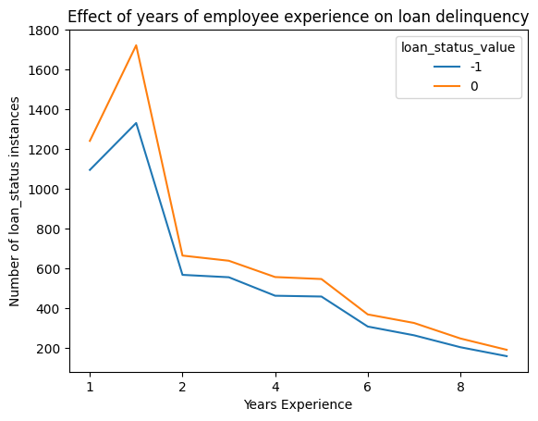
Univariate Segmented Analysis
As you can see more the years of experience, lesser the chance of loan delinquency.
The blue denotes all the 'Charged-off' accounts while the orange line denotes the 'Current' active loan accounts.

Slide 16
Univariate segmented analysis
The interest rate seems to be higher for the loans when we move from current loans to charged off loans
The number of 30+ months delinq in the last 2 years have between 8 and 10 as we move towards Charged Off loans

Slide 17
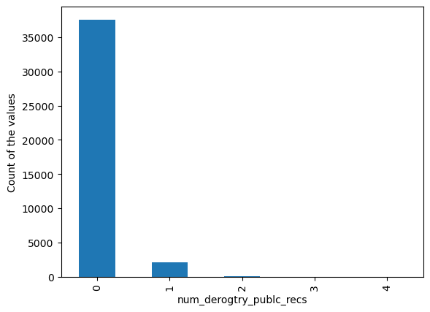
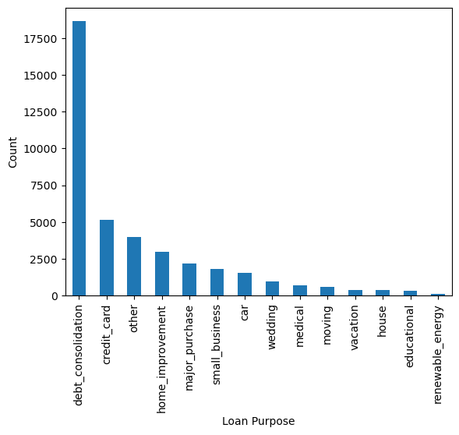
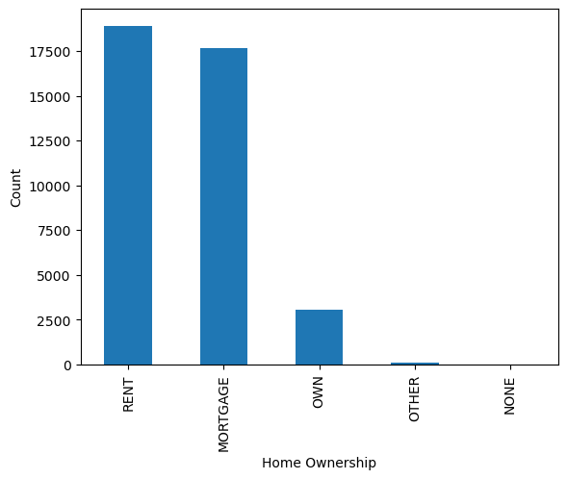

Bi and Multi variate analysis
Bivariate and multi variate analysis talks about relationships between columns and understanding their correlation. This helps us understand their behavior and influence of each other. Scatter plots and correlations are generally used for this analysis.

Slide 18
Bi and Multi variate analysis
This graph correlates the relationship between loan status and the years of experience. -1 = Charged Off accounts, 0 = current accounts
The scatter plot gives the relationship between loan grade and interest rate

Slide 19
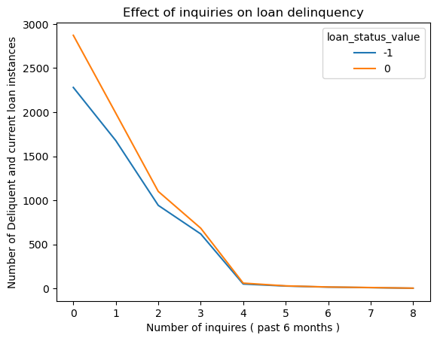
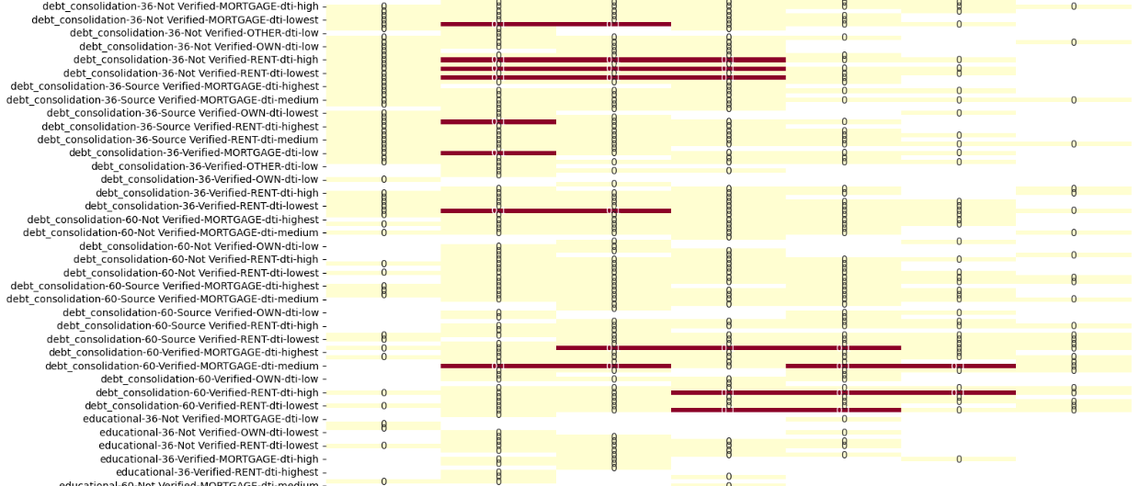
Bi and Multi variate analysis
This graph talks about the relationship between the delinquent loan instances vs the number of inquiries in the past 6 months
The heat map provides how the columns are correlated and some of the ones which are highly correlated. Columns (loan grade,purpose,term,src verification, home ownership, dti )
It shows that debt_consolidation, src – not verified, DTI being higher, Rent, Grades – B, C and D are some of the driving factors for Charged Off accounts

Slide 20
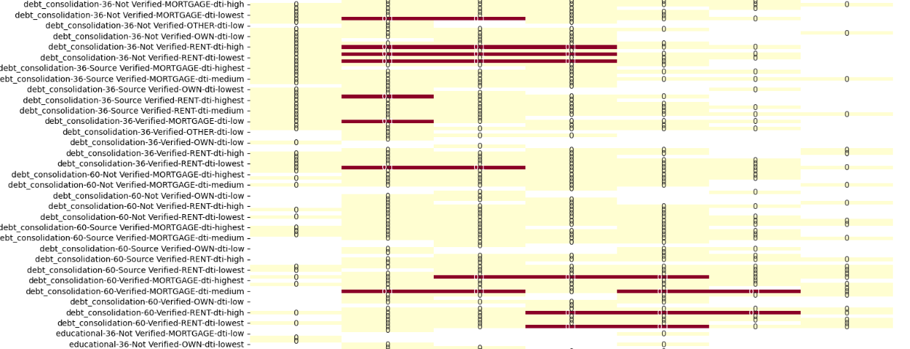
Bi and Multi variate analysis
The analysis was done on loan grade, verification status, home ownership, purpose, term and dti. All of them retrieved for Charged Off accounts.

Slide 21
Bi and Multi variate analysis
The analysis was done on loan grade, employment length in years, home ownership, purpose, term and dti. All of them retrieved for Charged Off accounts. This clearly shows a pattern where the charged off accounts have the following –
Employment Length – Low ( 1 to 2 years )
Loan Grade – B, C and D
Home Ownership – Rent and Mortgage
Loan Purpose – Debt-Consolidation and Credit card
DTI – Highest and Medium

Slide 22
Deciding Factors
The Conclusion
Loan Status
Assigned Loan Grade
Loan Purpose
Income Source Verification Status
Home Ownership
Debt To Income Ratio
Employment Length
Loan Amount
Interest Rate

Slide 23
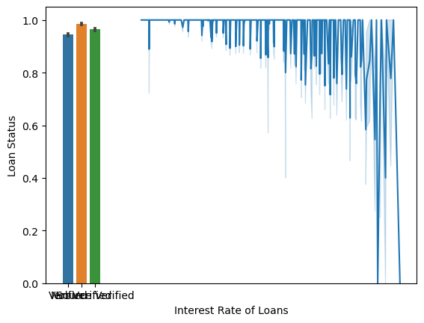
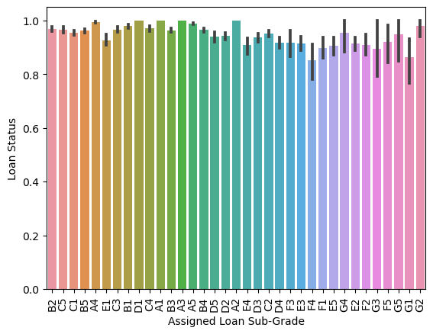
Summary
The analysis was done on loan grade, employment length in years, home ownership, purpose, term and dti. All of them retrieved for Charged Off accounts. This clearly shows a pattern where the charged off accounts have the following –
Employment Length – Low ( 1 to 2 years )
Loan Grade – B, C and D
Home Ownership – Rent and Mortgage
Loan Purpose – Debt-Consolidation and Credit card
DTI – Highest and Medium
Loan Value – The ones which are lowest are getting Charged Off, the others, they are trying to recover.
So, any borrowers, with the following parameters tend to pose a higher risk of delinquency and getting Charged off.

Slide 24


Team
Atharv
Nikhil

Slide 25
Thank you

